Slide 1





MEGA-MART
KEY PERFORMANCE INSIGHTS
KEY INSIGHTS THAT WILL HELP US SHARPEN OUR STRATEGIC FOCUS AND DRIVE BUSINESS GROWTH

Slide 2
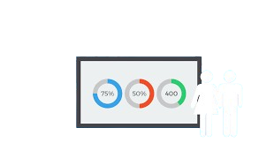
SALES PERFORMANCE KPIS
Our top-performing products and regions drive revenue, offering clear paths for growth.

Slide 3
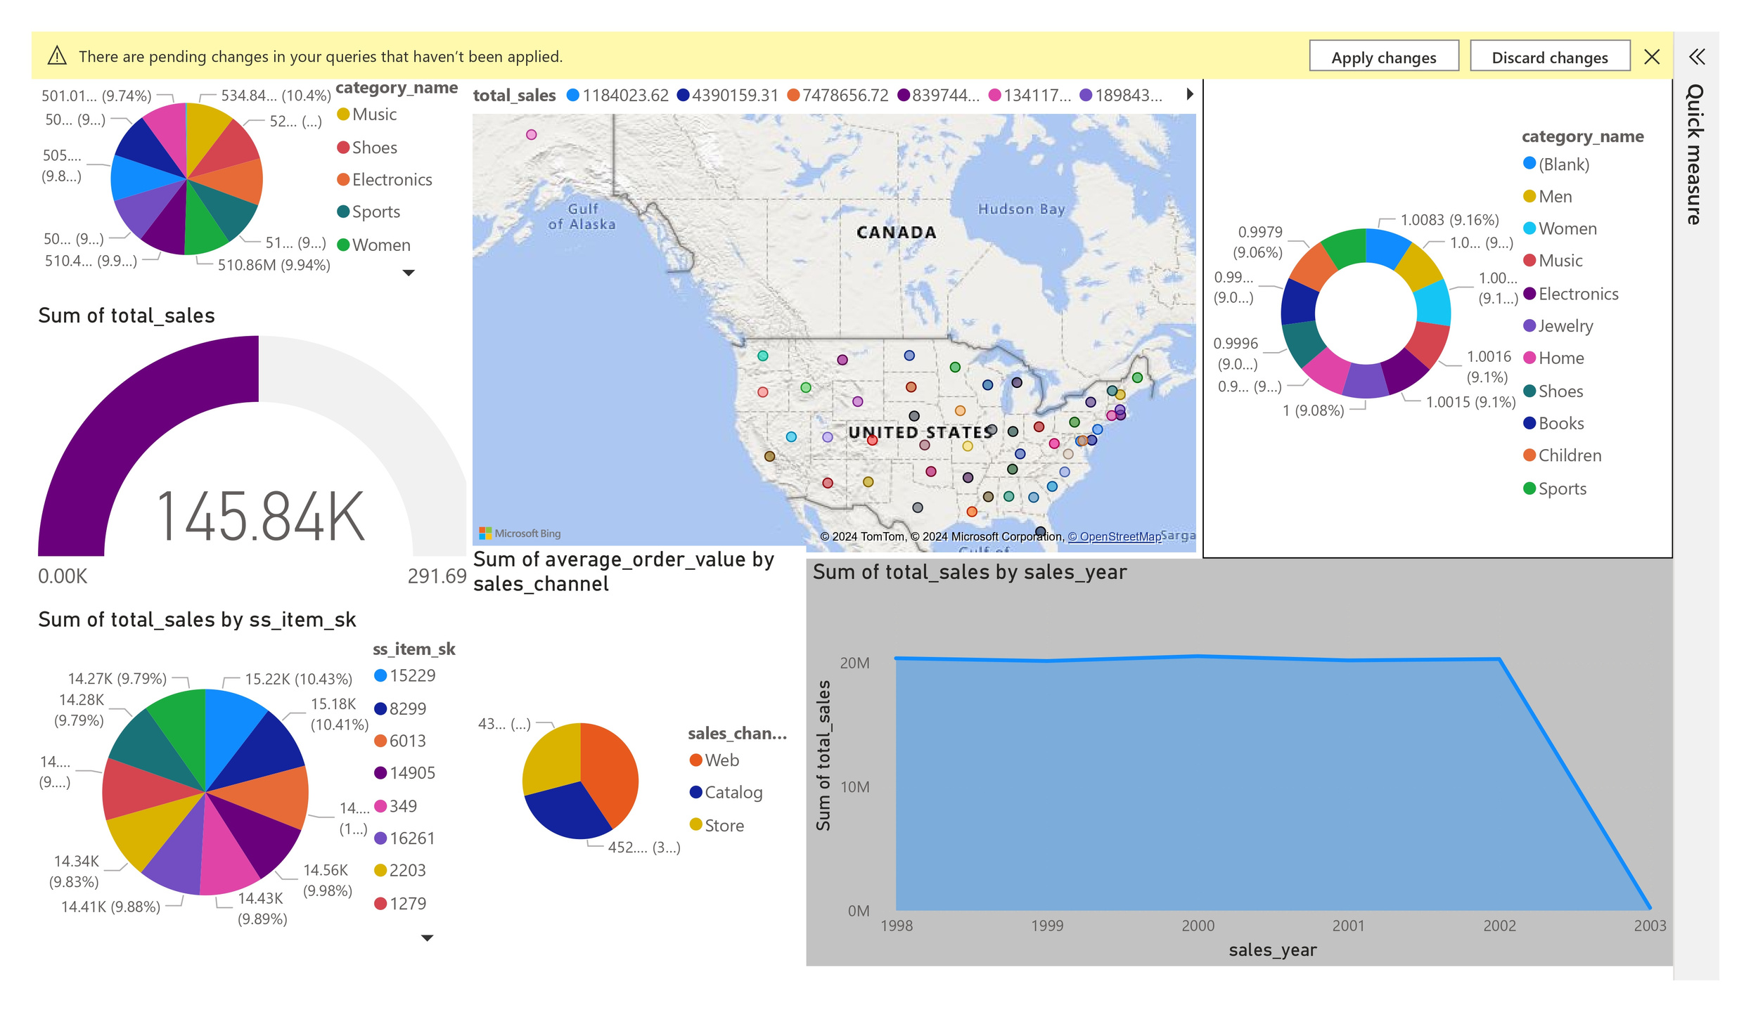

Slide 4

INVENTORY MANAGEMENT KPIS
Optimizing inventory turnover and stock levels will reduce costs and increase efficiency.

Slide 5
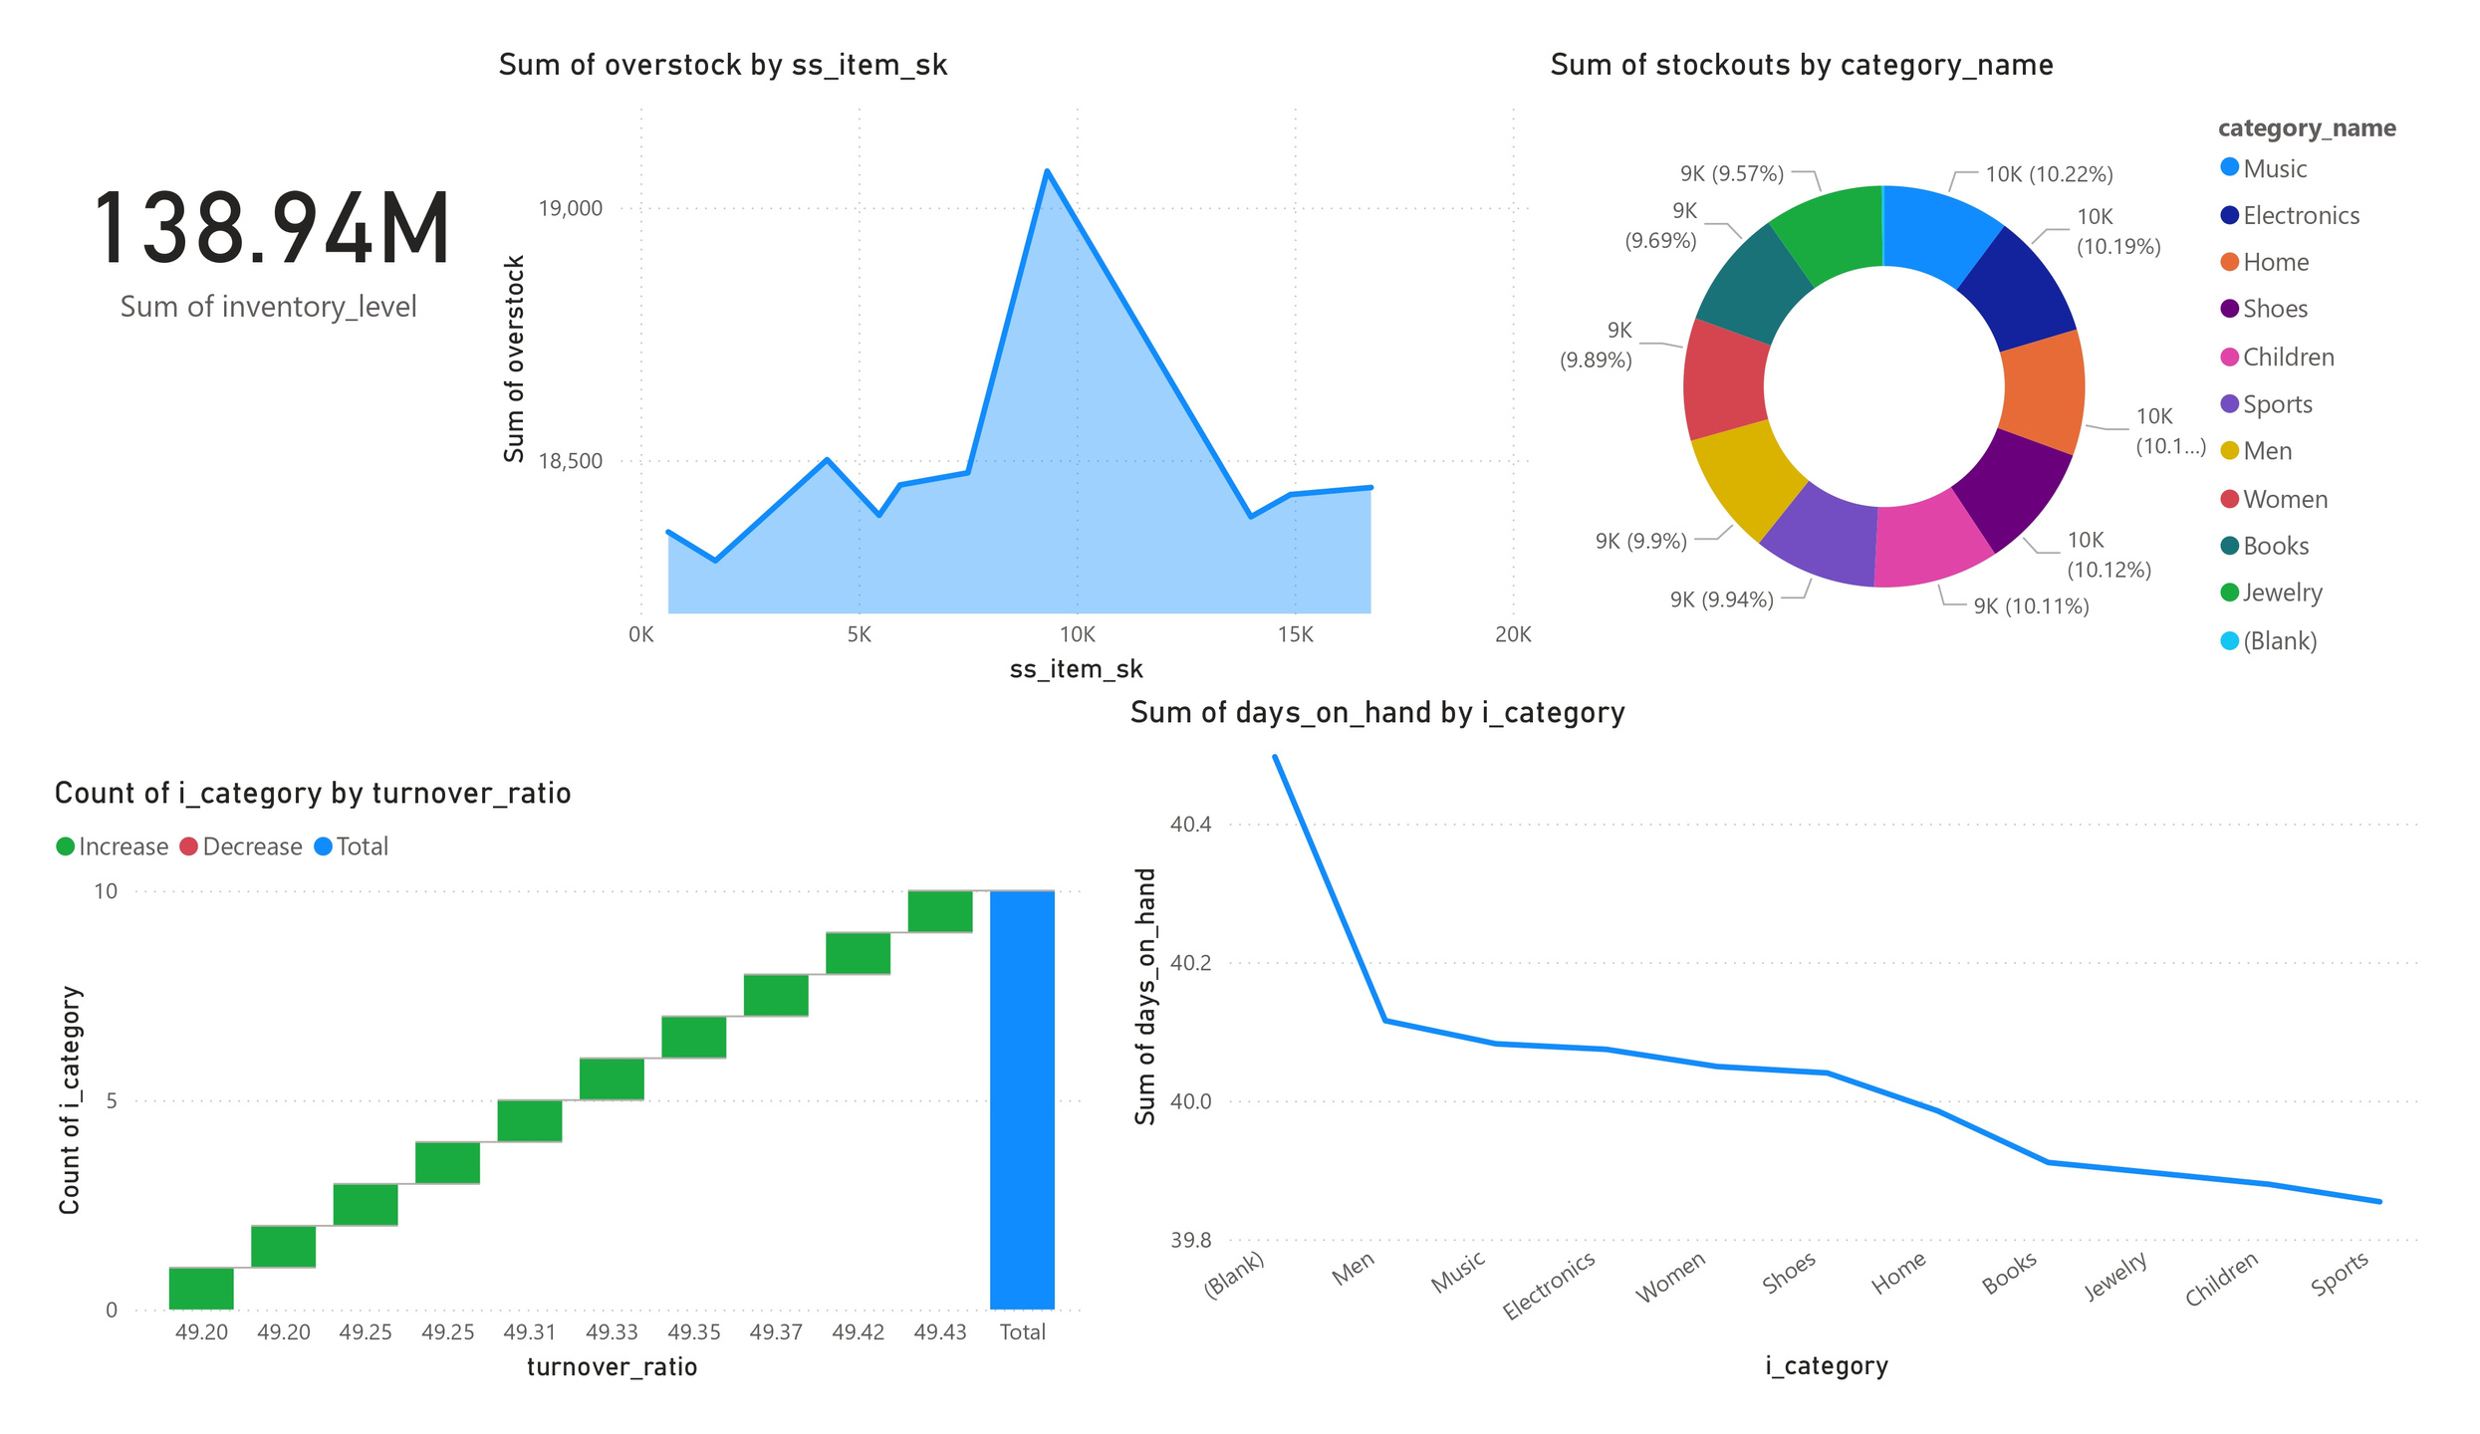

Slide 6

CUSTOMER BEHAVIOR KPIS
Understanding customer lifetime value and behavior is crucial to boosting loyalty and reducing churn.

Slide 7
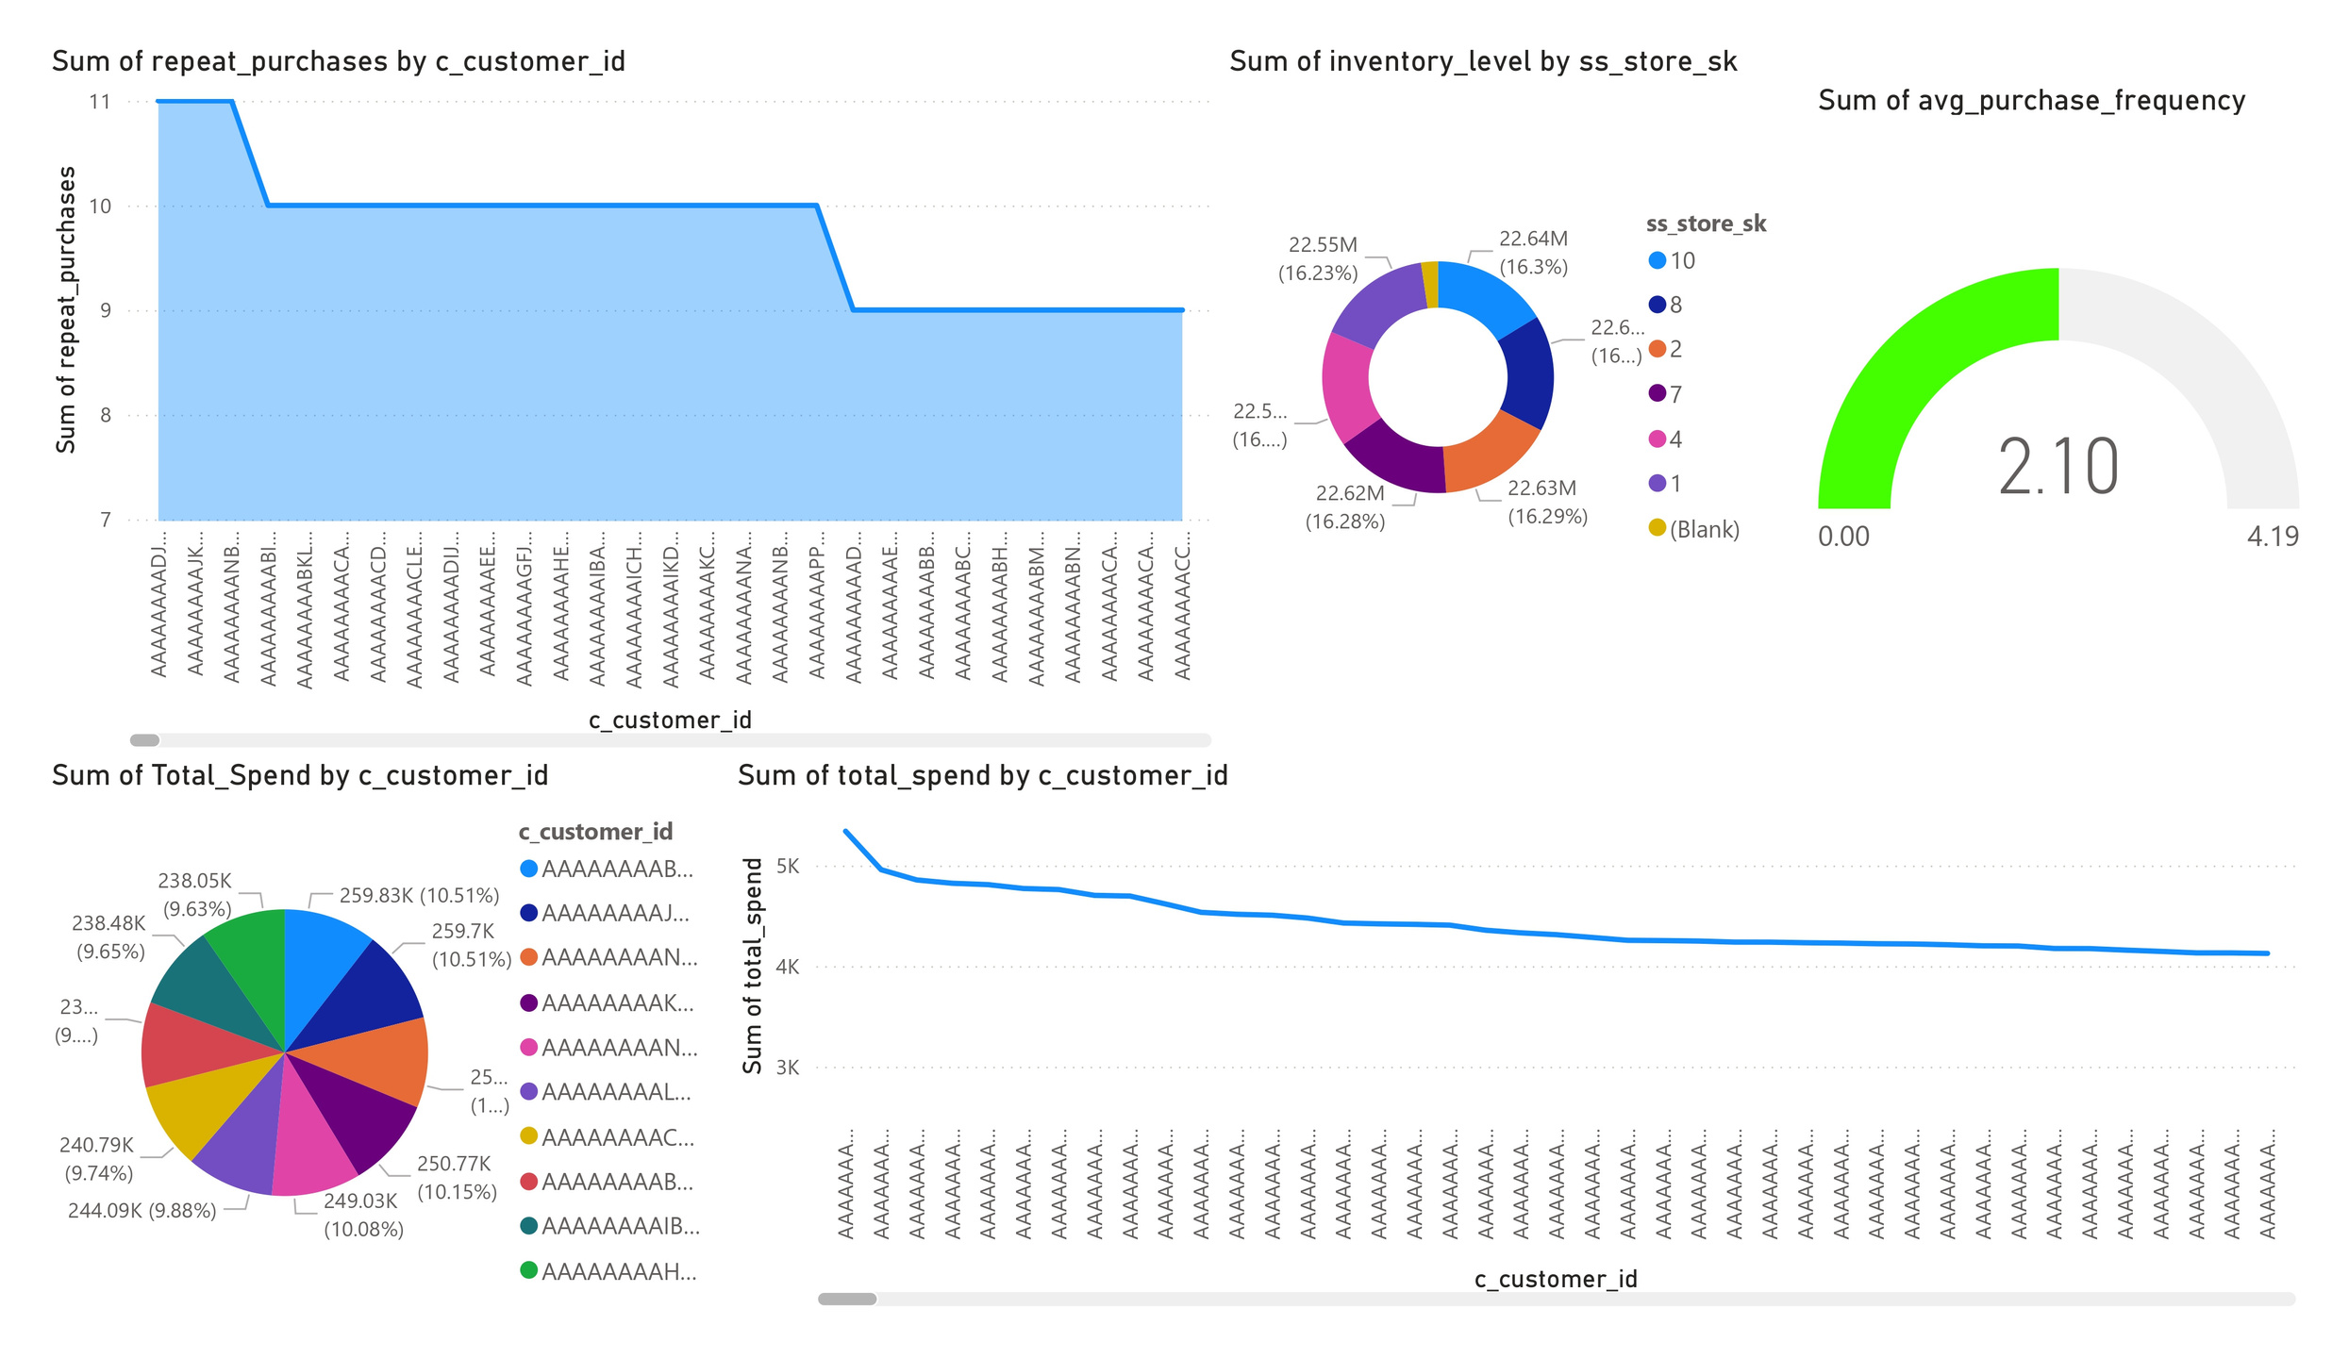

Slide 8

PROMOTIONAL EFFECTIVENESS KPIS
Focusing on high-ROI promotions can significantly enhance our sales performance.
76

Slide 9
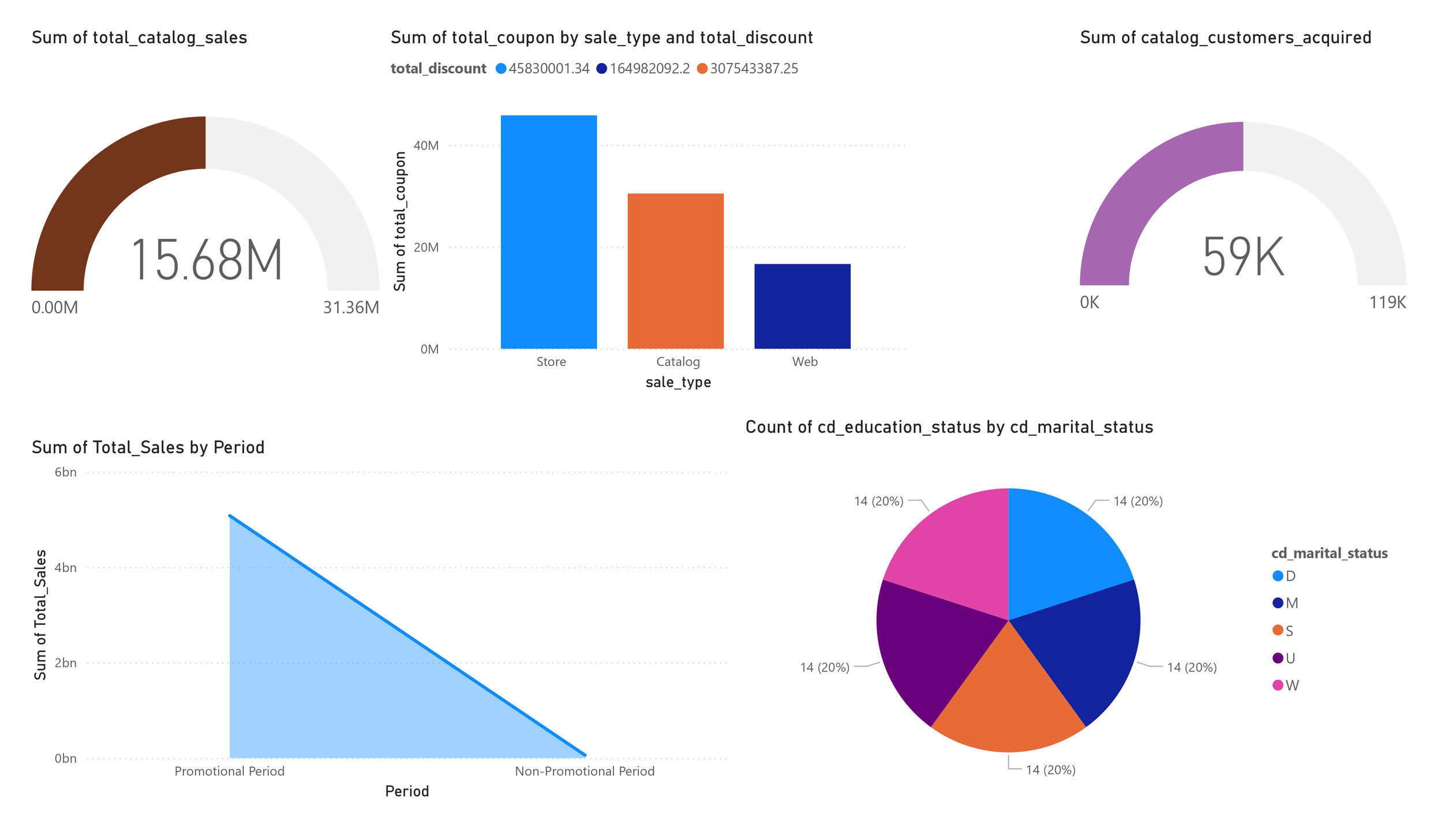

Slide 10
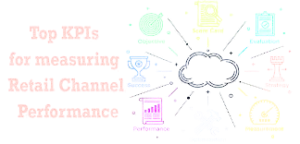
CHANNEL PERFORMANCE KPIS
Analyzing sales channels helps us prioritize the most profitable and efficient avenues.

Slide 11
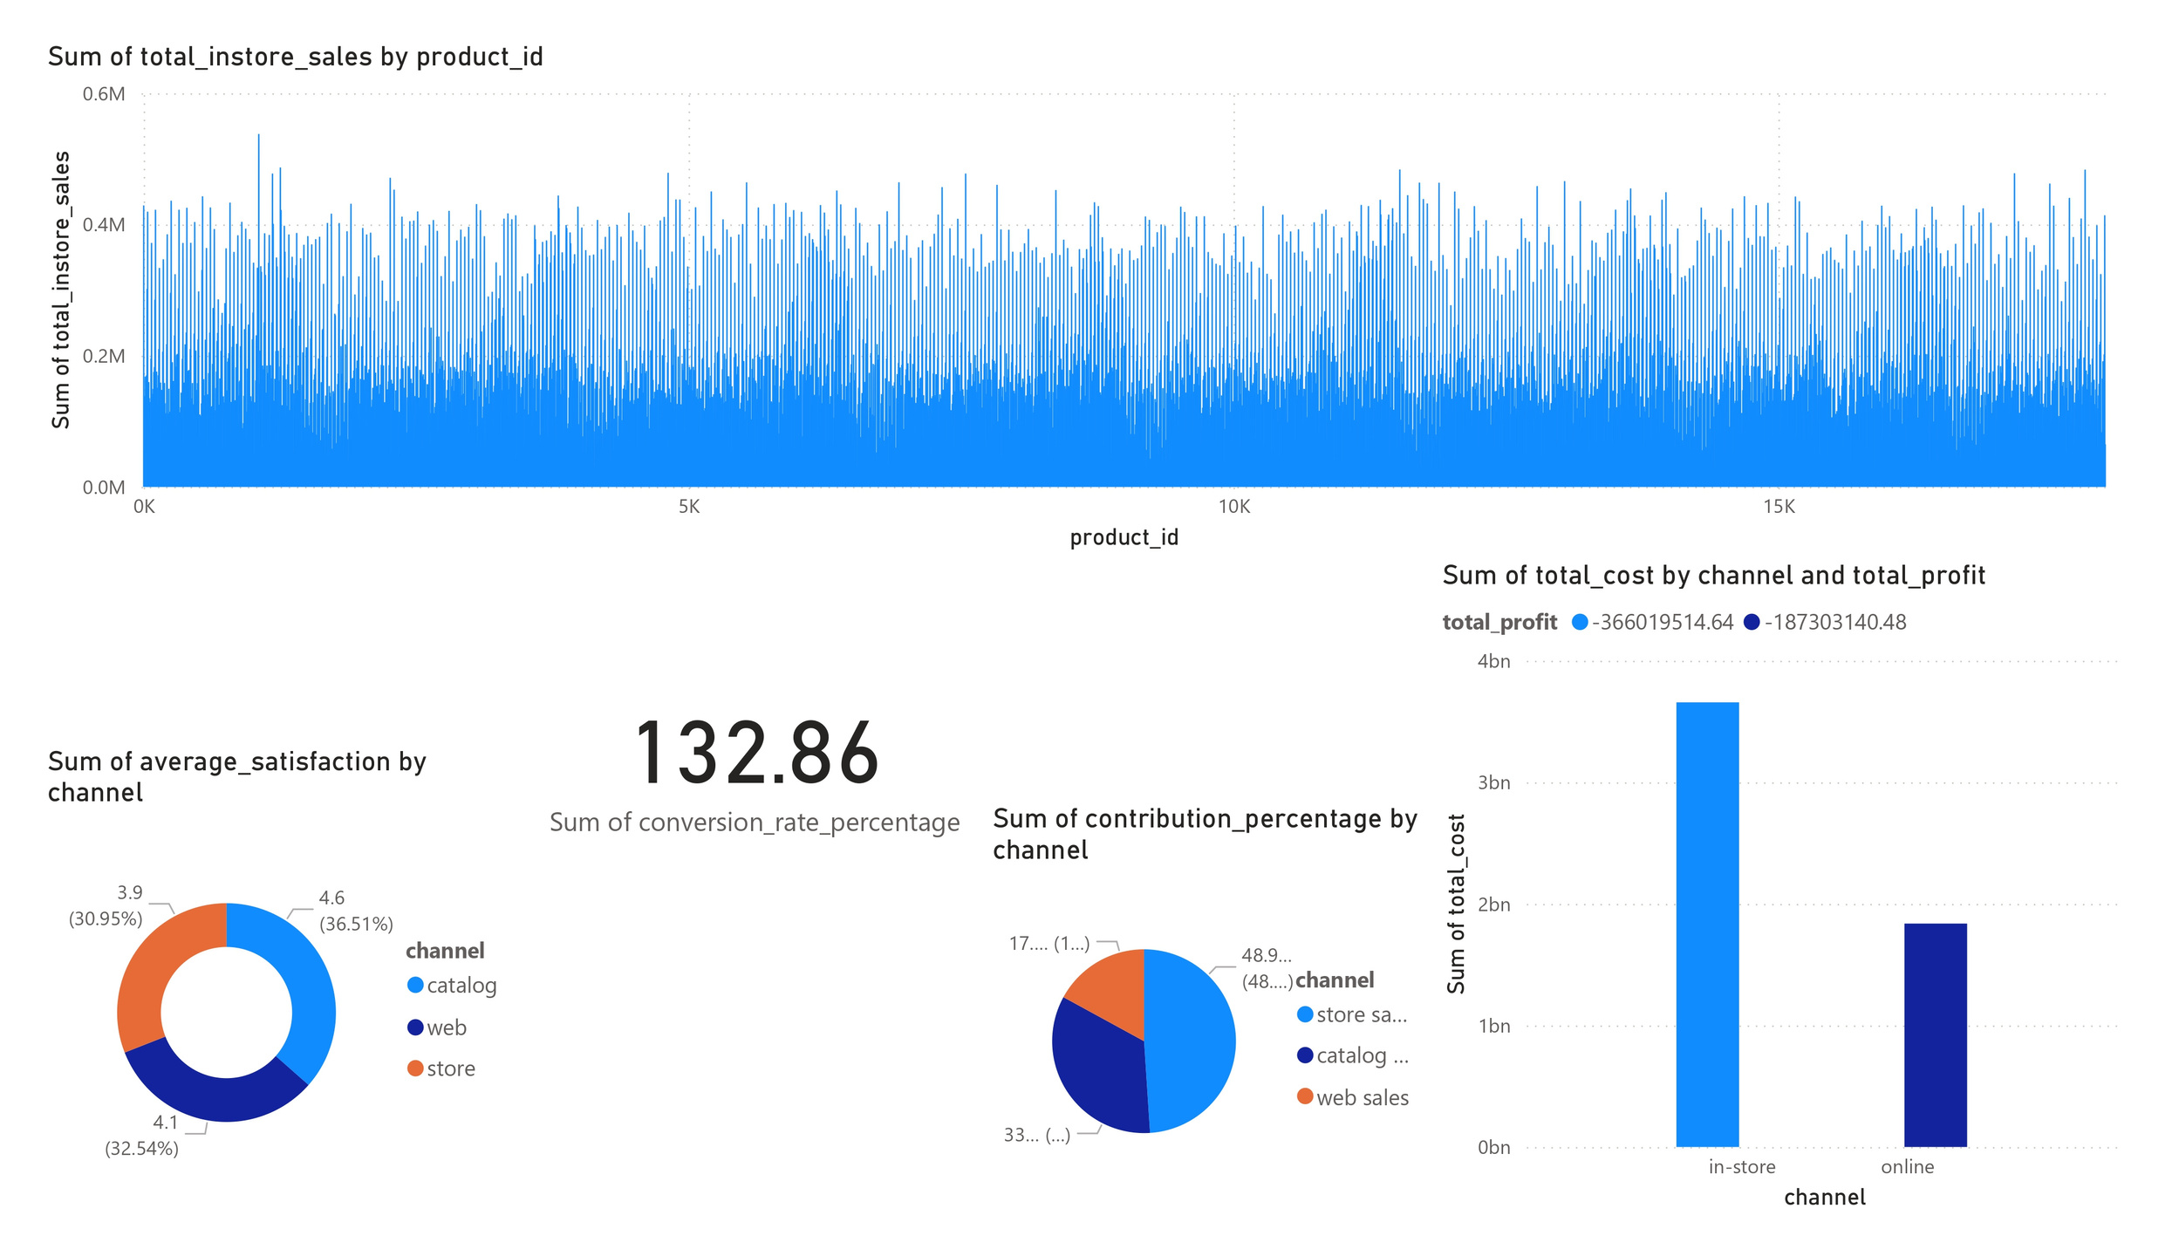

Slide 12
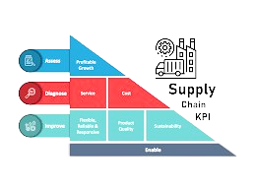
SUPPLY CHAIN
AND LOGISTICS KPIS
Streamlining order fulfillment and shipping times will improve customer satisfaction and reduce costs.

Slide 13
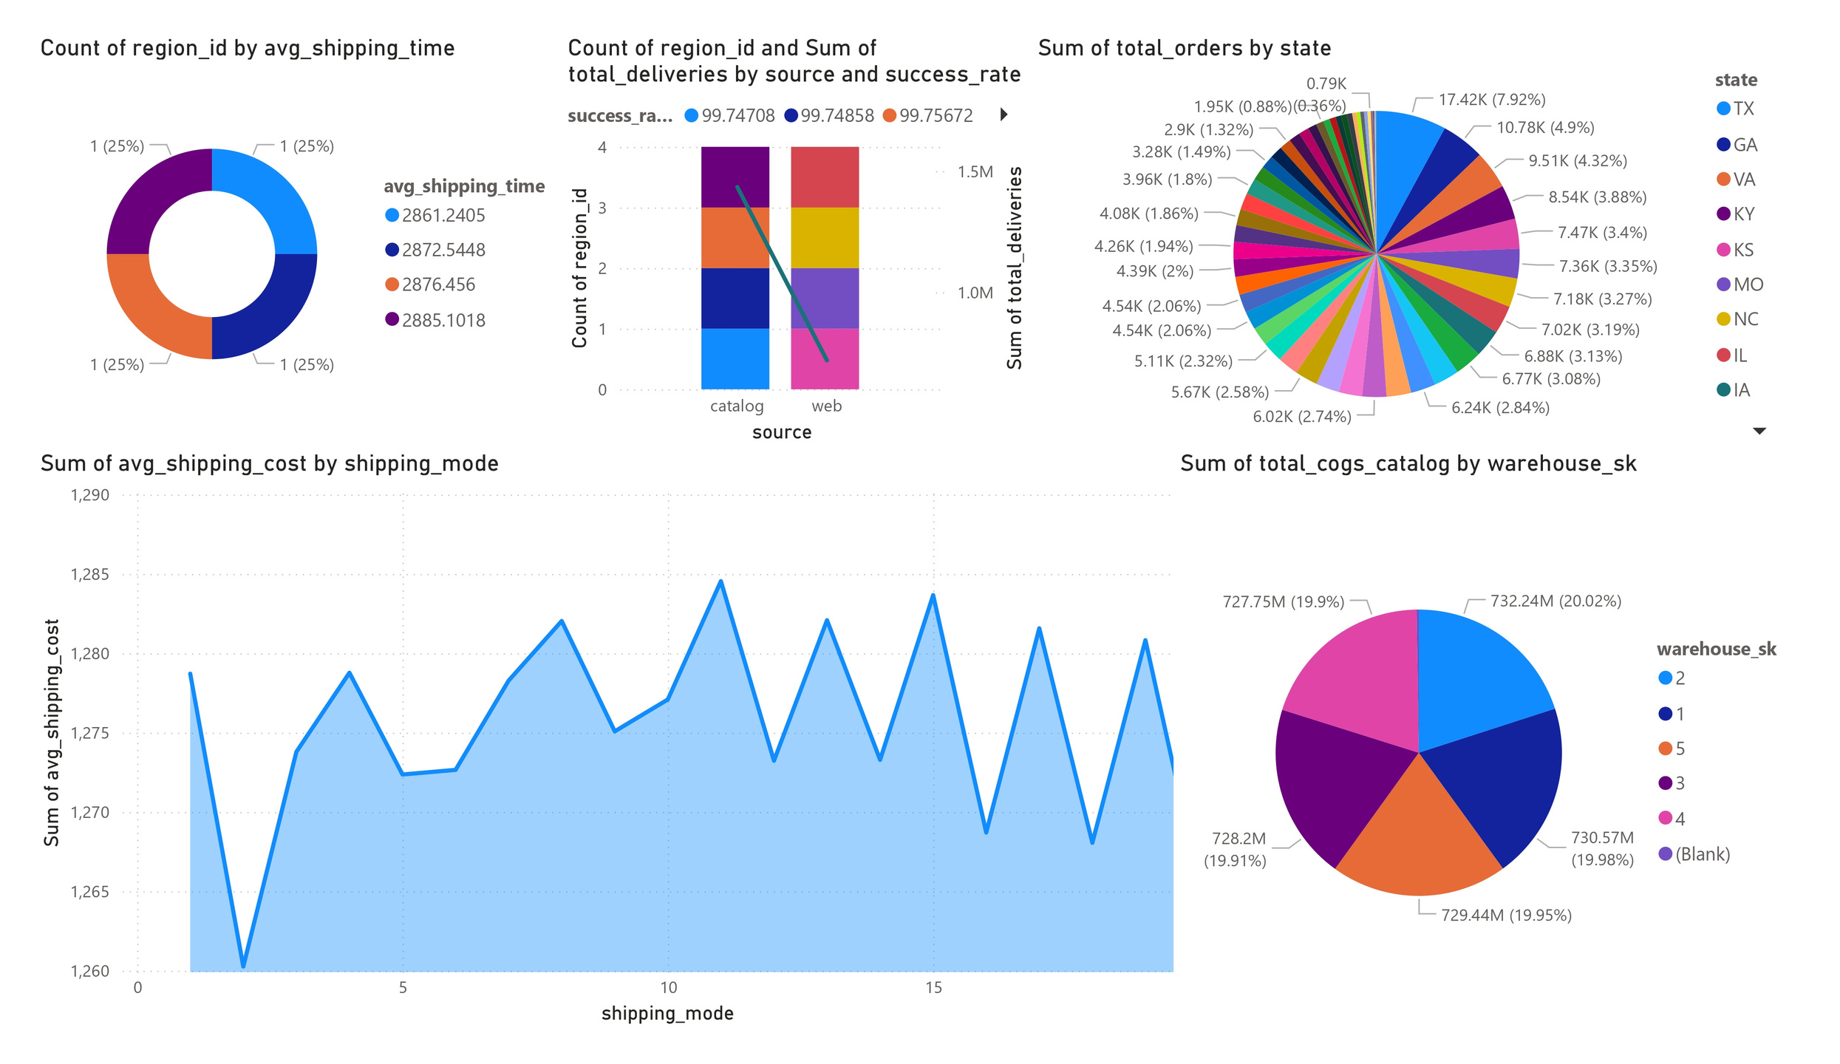

Slide 14
THANK YOU
CONTACT ME:
+91 7752953990
alok.sot010015.pwioi.com

